Slide 1
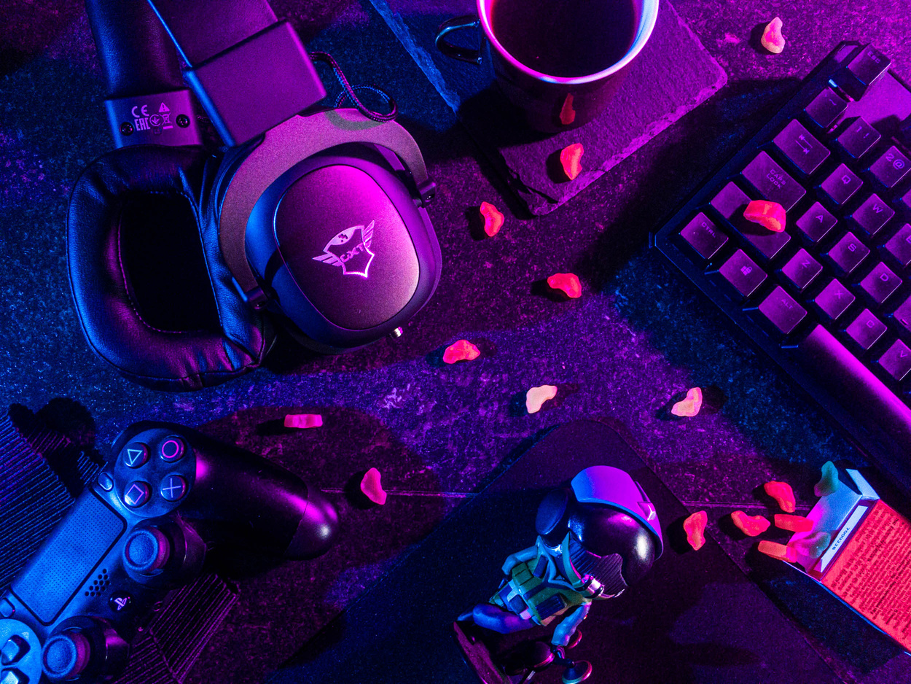

AI BASED AIMBOT
For Counter-Strike 2
BUILDING
GAME
AI

Slide 2

PROJECT OVERVIEW
01 PROBLEM
02 THE APPROACH
03 EXPERIMENTAL DESIGN
04 ANALYSIS OF DATA
05 CONCLUSIONS

Slide 3

Big fan of Counter Strike, but suck at the game???
Many counter strike players enjoy the game but find it difficult to point and shoot, which results in raging and a bad experience overall.
Our project aims to solve this problem to make gaming enjoyable to everyone, whether you are a pro or a noob.
(for educational purposes only)
(disclaimer: the following scripts have been executed on a local offline server. please don’t try this with your official steam account)
01 THE PROBLEM

Slide 4

02 THE APPROACH
(let the machines take over)

Slide 5

I. YOLO
YOLO, Also Known as You Only Look Once is one of the most powerful real-time object detector algorithms. It is called that way because unlike previous object detector algorithms, like R-CNN or its upgrade Faster R-CNN it only needs the image (or video) to pass one time through its network.

Slide 6

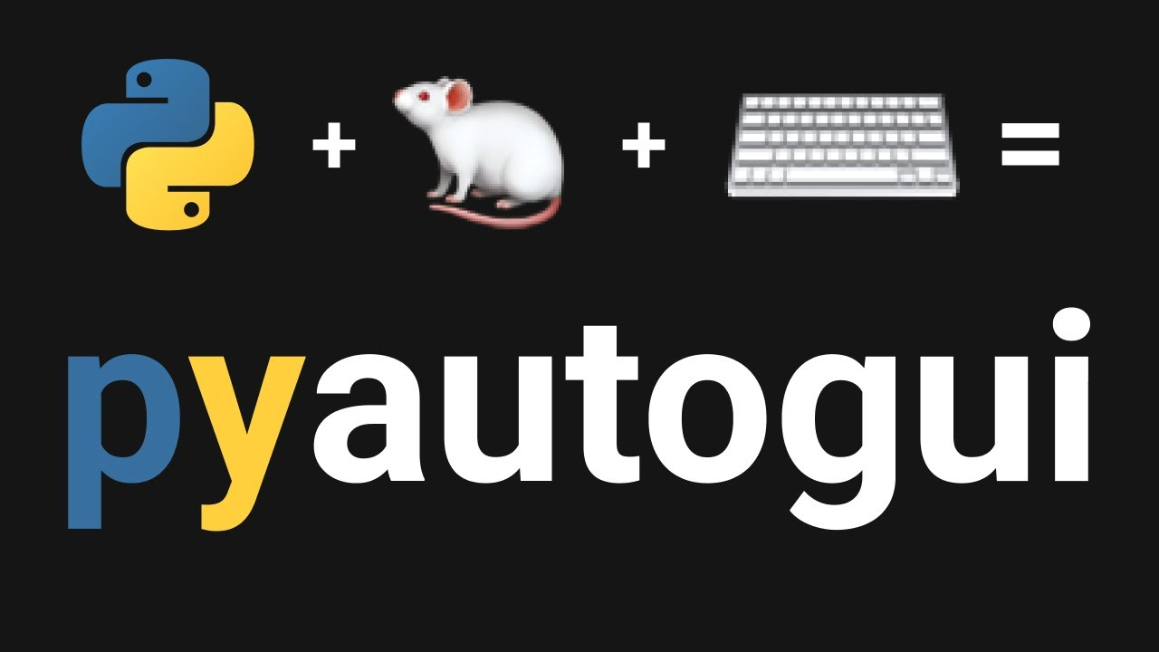

II. PYAUTOGUI
PyAutoGUI is a cross-platform GUI automation Python module for human beings. Used to programmatically control the mouse & keyboard.

Slide 7

03 EXPERIMENTAL DESIGN
How did we do it?

Slide 8
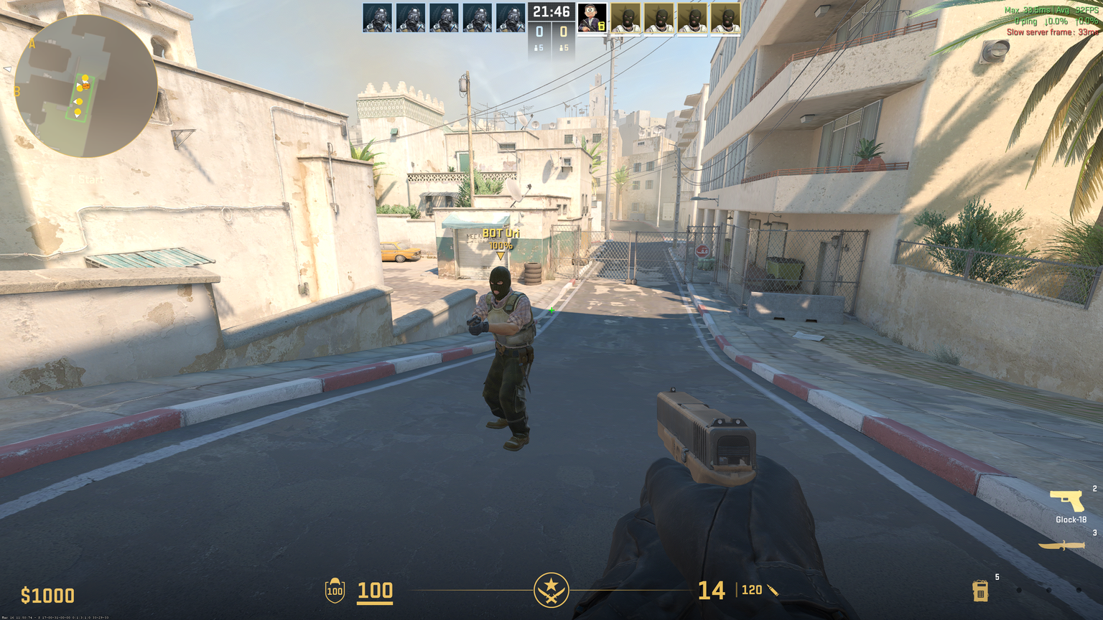
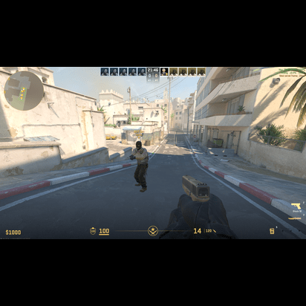
I. IMAGE PREPROCESSING
Take an image from the game and convert it to something the model understands

Slide 9

II. OBJECT DETECTION
(TRAINING THE MODEL)
Feed the images to the YOLO model to return detected objects

Slide 10
III. CURSOR POSITIONING
The script calculates the center of the bounding box by averaging the x- and y-coordinates of the box. The cursor is then moved to the center point using the pyautogui library’s move to() function, ensur- ing that the mouse cursor is aligned with the opponent’s head or body.
IV. CALIBRATION
The cursor movement and the game environment may have minor discrepancies, affecting the aimbot’s accuracy. To address this issue, the script includes a calibration mechanism that adjusts the cursor position and the game environment to ensure a more precise targeting experience.

Slide 11
V. SHOOTING MECHANISM
The aimbot script includes a shooting mechanism that triggers a left mouse button click when the cursor is positioned over the opponent’s bounding box. This mechanism can be adjusted based on the player’s preference and the game’s requirements.
VI. LOOP
The script runs in a continuous loop, constantly monitoring the game environment and updating the cur- sor position as needed. This ensures that the aimbot re- mains responsive and can effectively target opponents in real-time.

Slide 12
DEMO

Slide 13
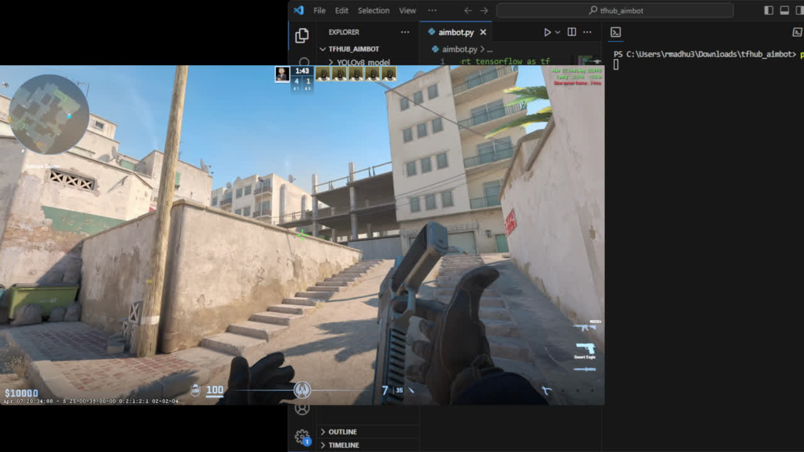

Slide 14

04 ANALYSIS OF DATA
Results

Slide 15
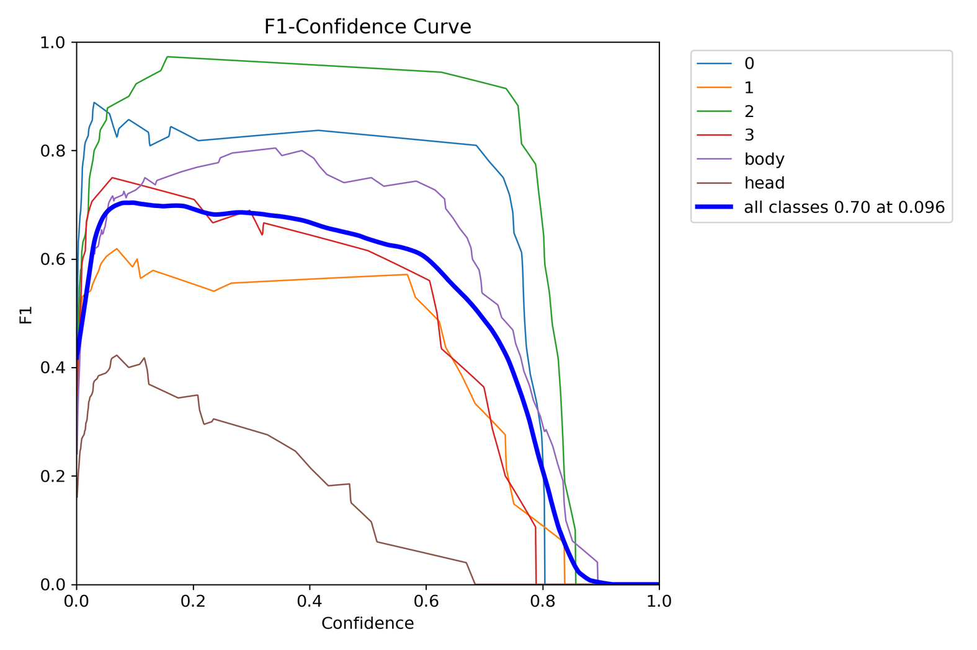
I. FOCUS ON HIGH CONFIDENCE PREDICTIONS
Notes:
Focus on High Confidence Predictions(Figure 1):
The model is prioritizing certainty over comprehensive- ness. As the confidence threshold increases, the model predicts with more certainty, but it might miss some true positives (correct detections).
Trading Precision for Recall(Figure 1):
Initially, increasing confidence might improve precision (reducing false positives). But as the threshold gets too high, the model might become overly cautious, sacrific- ing recall (missing true positives) to maintain high confi- dence.

Slide 16
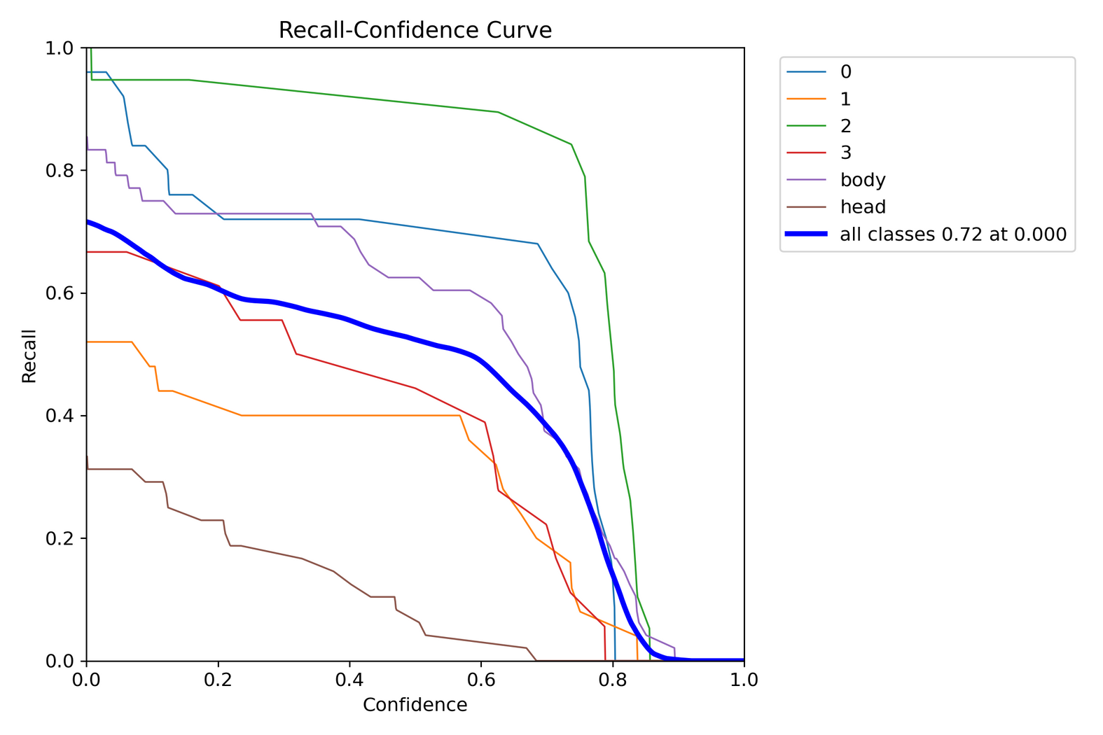
II. FOCUS ON HIGH CONFIDENCE PREDICTIONS
Notes:
model is prioritizing certainty over comprehensiveness.
X-axis (Confidence): This represents the model’s cer- tainty in its classifications. A higher confidence score indicates the model is more confident in its prediction.
• Y-axis (Recall): This represents the model’s ability to find all relevant instances. A higher recall means the model is catching most of the actual positive cases.
As the confidence threshold increases (moving left on the x-axis), the model becomes more picky about what it classifies as positive.
• This can lead to higher precision (fewer false posi- tives) because the model is only classifying things it’s very confident about.
• But,itcanalsoleadtolowerrecall(missingsometrue positives) because the model might be excluding some valid cases due to its high confidence threshold.

Slide 17
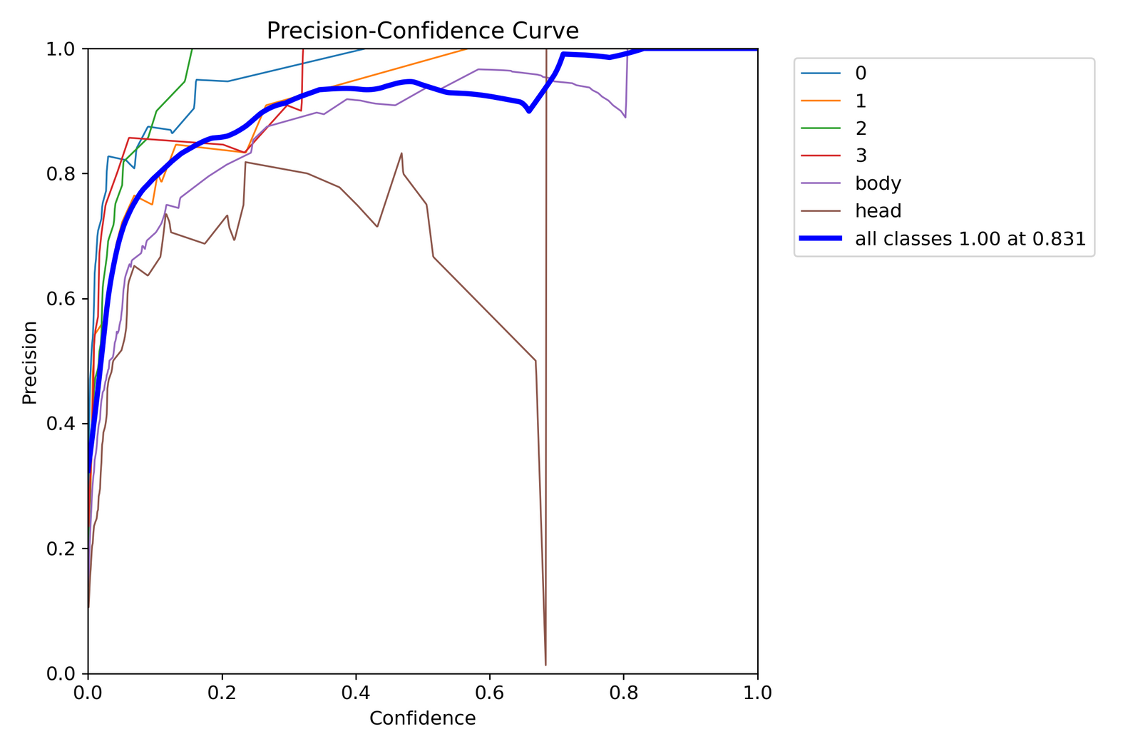
III. PRECISION GOES UP WITH CONFIDENCE
Notes:
Precision goes up with confidence(Figure 3), it indi- cates that the model is better at filtering out incorrect detections as its confidence in its predictions increases. Here’s a breakdown of what’s happening:
• High Confidence, High Precision: When the model is very confident (high confidence on the x-axis), most of its predictions are correct (high precision on the y- axis). This is ideal.
• Low Confidence, Lower Precision: When the model is less confident (low confidence on the x-axis), it’s more likely to make mistakes (lower precision on the y-axis). There are more false positives (incorrect de- tections).

Slide 18
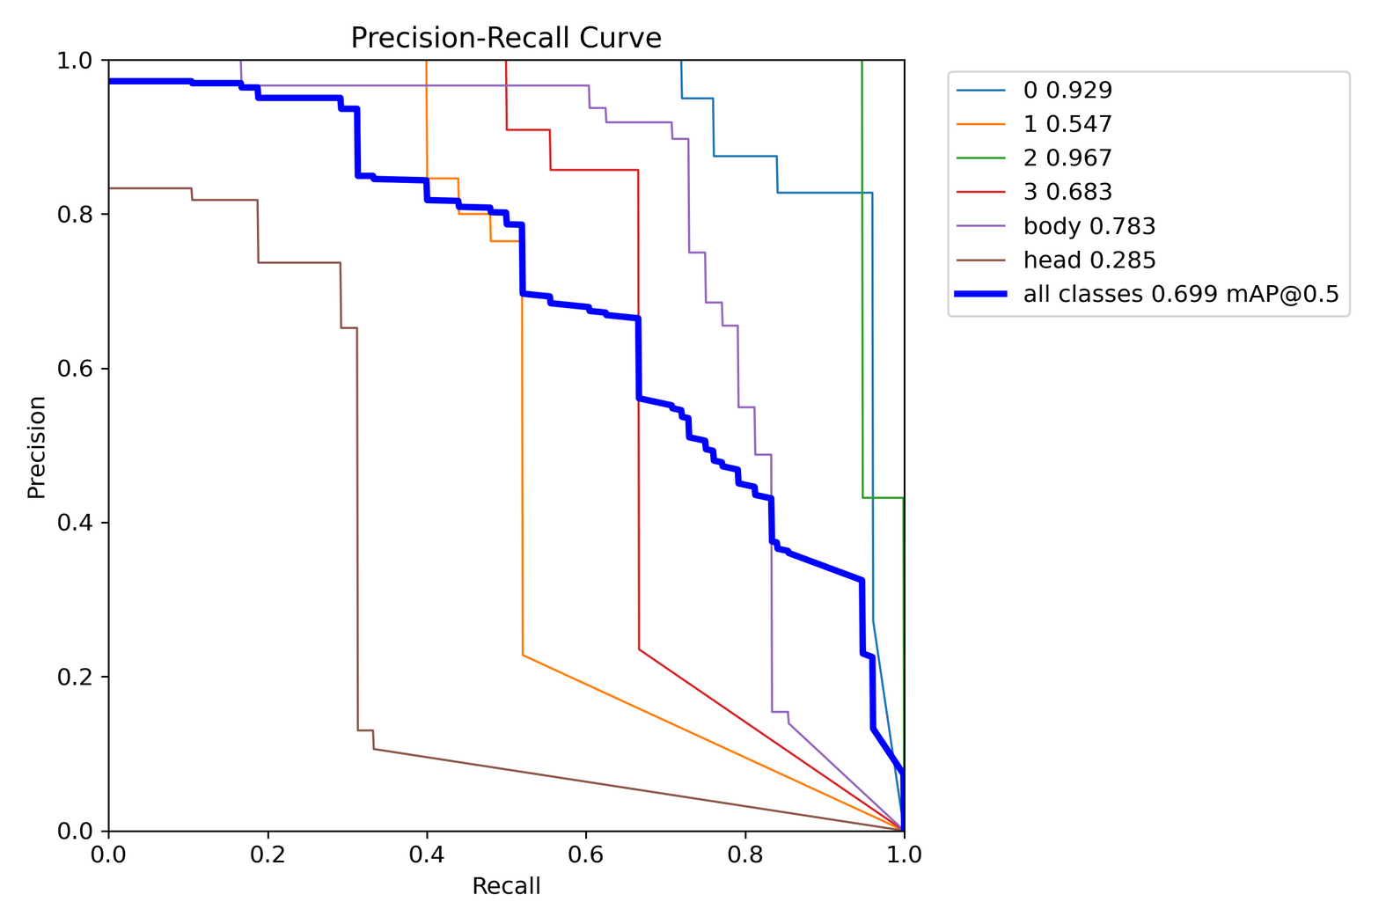
IV. PRECISION VS. RECALL
Notes:
The curve shows the model’s performance at different confidence thresholds. As the threshold for classifying something as positive increases (moving left on the x- axis), the model becomes more selective.
This selectivity leads to higher precision (fewer false positives) but lower recall (potentially missing true pos- itives). Conversely, as the threshold decreases (moving right on the x-axis), the model becomes less selective and recall increases (more true positives are captured) at the cost of precision (more false positives).

Slide 19
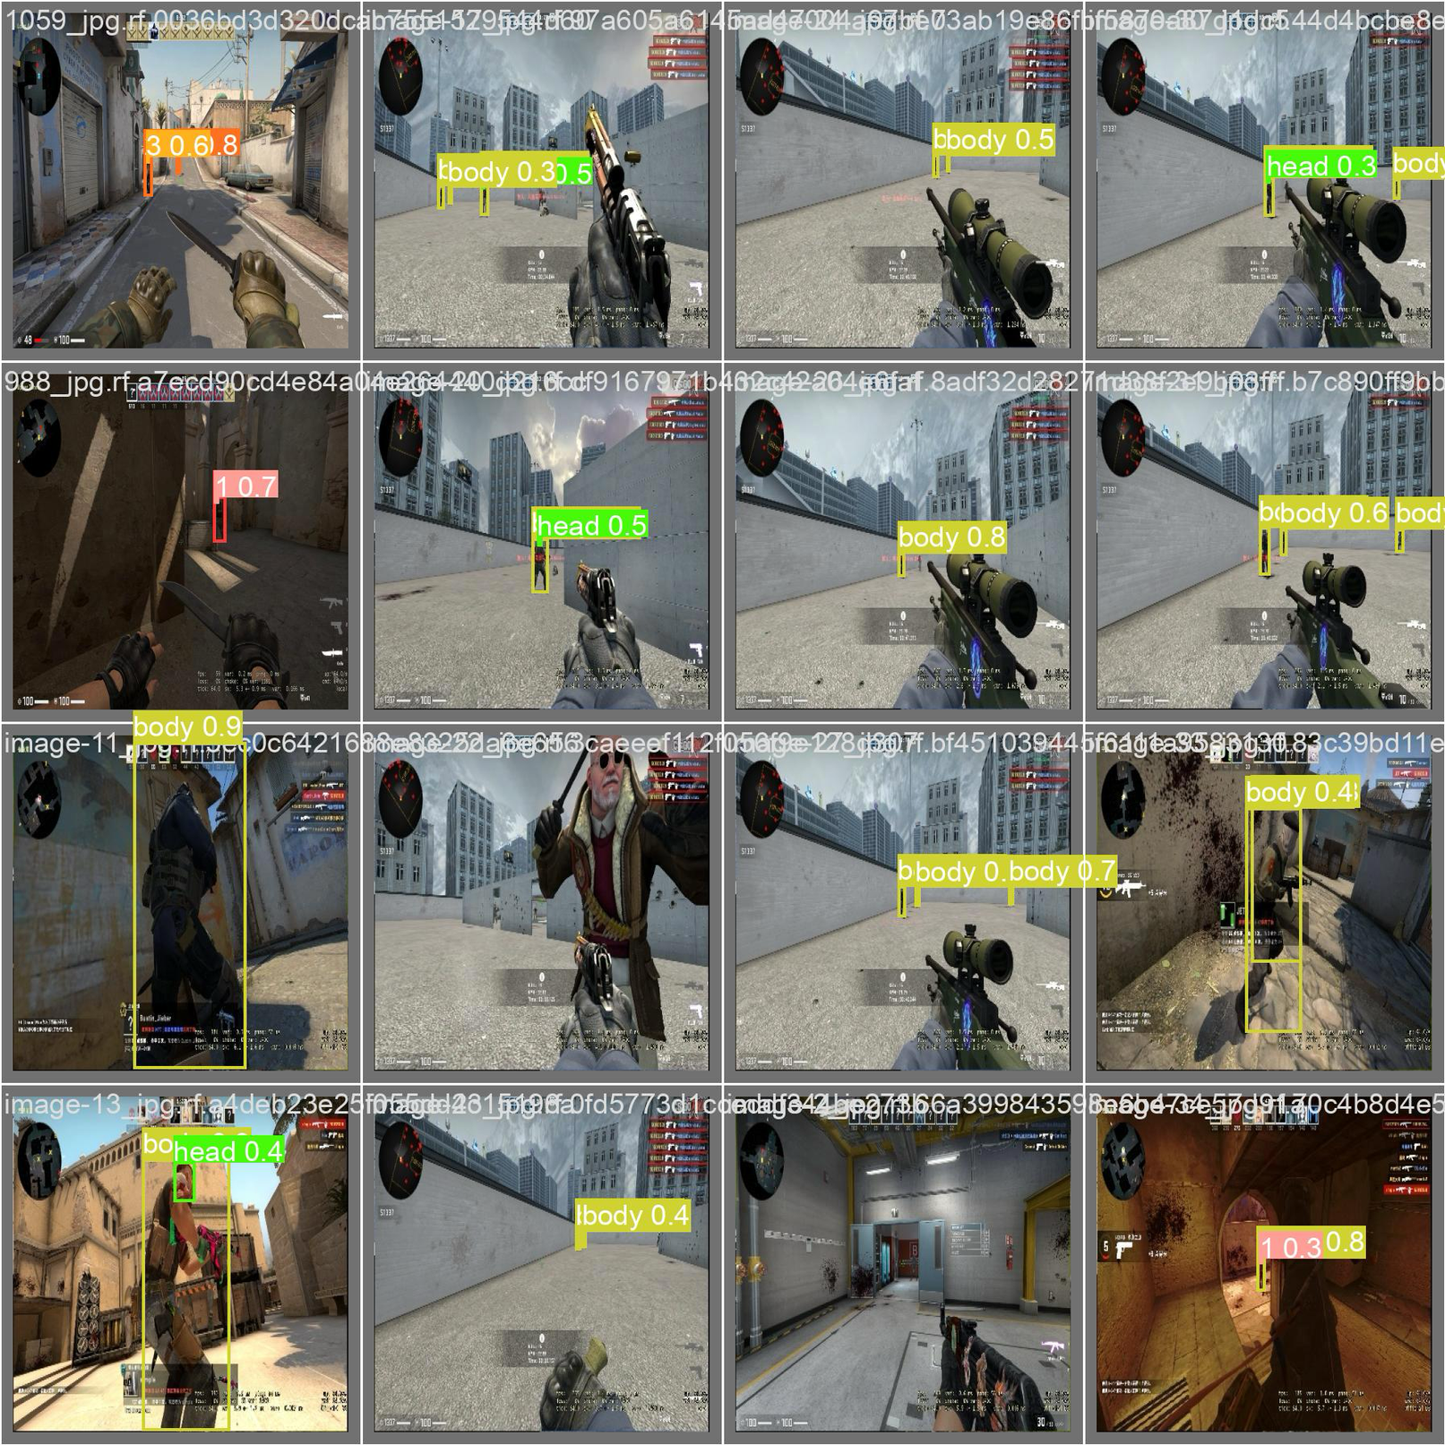
V. MODEL OUTPUT
(WHAT THE MACHINE SEES)
Notes:
The curve shows the model’s performance at different confidence thresholds. As the threshold for classifying something as positive increases (moving left on the x- axis), the model becomes more selective.
This selectivity leads to higher precision (fewer false positives) but lower recall (potentially missing true pos- itives). Conversely, as the threshold decreases (moving right on the x-axis), the model becomes less selective and recall increases (more true positives are captured) at the cost of precision (more false positives).

Slide 20

05 CONCLUSION
Our project represents a significant advancement in AI-driven gaming technology, offering players of all skill levels a more enjoyable and balanced gaming experience. As we continue to refine our approach, we envision a future where AI seamlessly enhances gameplay while upholding principles of fairness and inclusivity.
Furthermore, the implications of our project extend beyond gameplay enhancement. The robustness and precision of our AI aimbots hold promise for improving anti-cheat software in games. By detecting and responding to in-game anomalies with high accuracy, our technology has the potential to bolster existing anti-cheat measures, ensuring a level playing field for all players and preserving the integrity of the gaming experience.

Slide 21
THANK YOU

